Slide 1
Good Things
Announcements:
End of Grading Period is Tomorrow! Make sure you’ve done everything you can to make your grade the very best.
November 11 is the Unit 2.1 Part 2 DCA
Wish Mr. Crellin a Happy Birthday Tomorrow!

Slide 2
Aquifer Activity
Design your own Aquifer

Slide 3
Objective
Your job is to work as a team to design a model that shows how an aquifer works. You should discuss things as a team and share ideas, but each person complete his/her own report sheet.
Team of 4 members.
At this time write the name of your team members on your Worksheet.

Slide 4
Before you construct your Aquifer
You must have your plan initialed before you can actually begin to make it.
Day 1- Planning
Day 2- Construction
You have a limited amount of time to plan so use your time wisely!

Slide 5
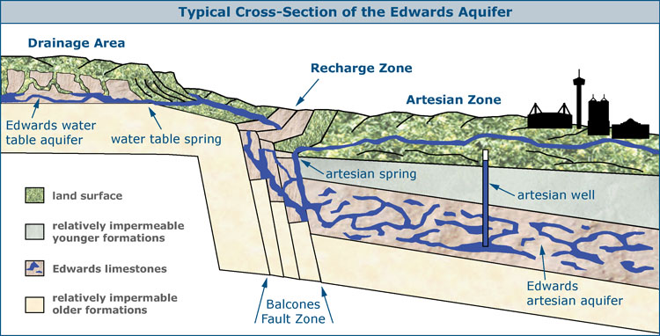
What is an Aquifer?

Slide 6
Edwards Aquifer
How the Edwards Aquifer works

Slide 7
Answer the following question on your worksheet
What is an aquifer and how does it work?

Slide 8
Point source vs. Non-point Source Pollution

Slide 9
Answer the following question on your worksheet
What is point source and non-point source pollution?

Slide 10
Let’s see if you can design your own Aquifer!

Slide 11
Brainstorm:
How can you use the following materials to construct a model of an aquifer? Use food coloring to demonstrate water pollution in an aquifer.
1- 100mL beaker
100 mL of gravel
20 mL of dry sand
Cup of water
Food coloring (red, blue or green)

Slide 12
Notes:
Day 1:
You can ONLY use the materials listed.
Explain how you are going to use the model to show how an aquifer works.
Brainstorm your ideas on the back of the handout.
Write a procedure on how to construct your model (number each step). A diagram of your model will also be helpful.
GET THE TEACHERS INITIALS BEFORE YOU TRY OUT YOUR IDEA TOMORROW!
Day 2:
Follow your procedure!
All work needs to be done on the back of the handout and turned in at the end of class.

Slide 13
Back of worksheet Set-up:
Day 1:
Brainstorm
Team Objective/Purpose:
Team Materials:
Explain how the materials your team selected for your model will demonstrate how an aquifer works.
Procedures: Remember to number your procedures to construct your model.

Slide 14
Back of worksheet Set-up:
Day 2:
Gather materials to construct your model.
Follow your procedures
Analysis/Conclusion:
Did your model demonstrate how an aquifer works as you explained in day one? Explain your observations.
Explain how you demonstrated water pollution
Did your model demonstrate point source or non-point source pollution?

